Slide 1
MKSSS’s CUMMINS COLLEGE OF ENGINEERING WOMEN
The project presented under the Domain of Machine Learning is entitled as
“CodeMyStics "
Enhancing Security and Safety through
Human Hand Detection
By
Sanika Nanavare
Srushti Pophale
CodeMystics

Slide 2

Outline
Problem Statement
Introduction
Objective
Motivation
Hardware and Software Requirements
Literature Survey
Need And Salient Features
Comparison of Algorithm
System Architecture
Working of the System
Real Time Application
Project Time and Cost Estimate
Future Scope
Conclusion

Slide 3
Problem Statement
To detect the posture of the human hand in working area to prevent accidents
Environment Synchronized Advanced Security Alerting, Danger Prevention and Accident Risk Mitigation System based on Real-Time Detection and Classification of Human Body Posture Using OpenCV, AI, and Deep Learning with CCTV and Alarm interfaces enabled.
If the posture is detected in that dangerous working area then the machine can immediately be stopped and an alarm will ring to alert the person.

Slide 4
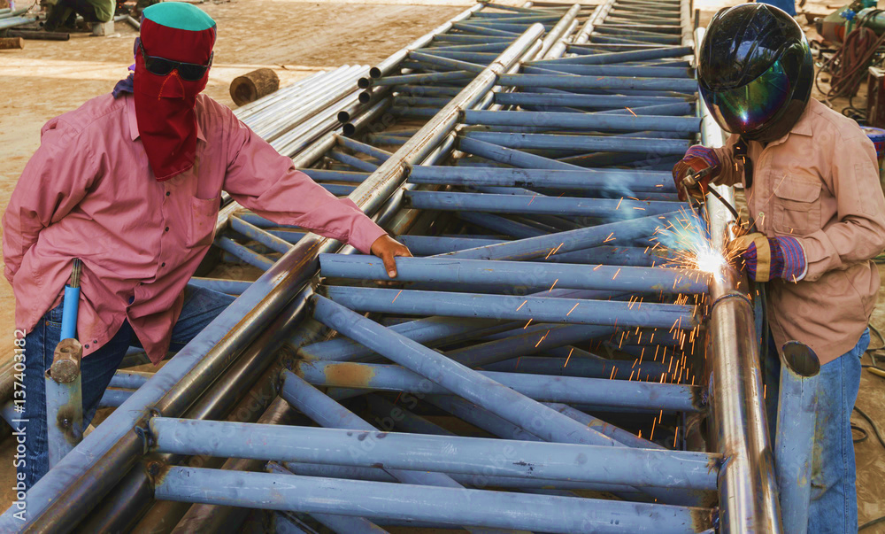
Introduction
The aim of this project is to apply the Deep Learning model to detect a posture of a human in the working area.
To avoid a human accident while machine operation.
To train a model on historical, labeled data
Exploring alternative solutions that do not involve the use of sensors
SafeZoneInnovator
3

Slide 5
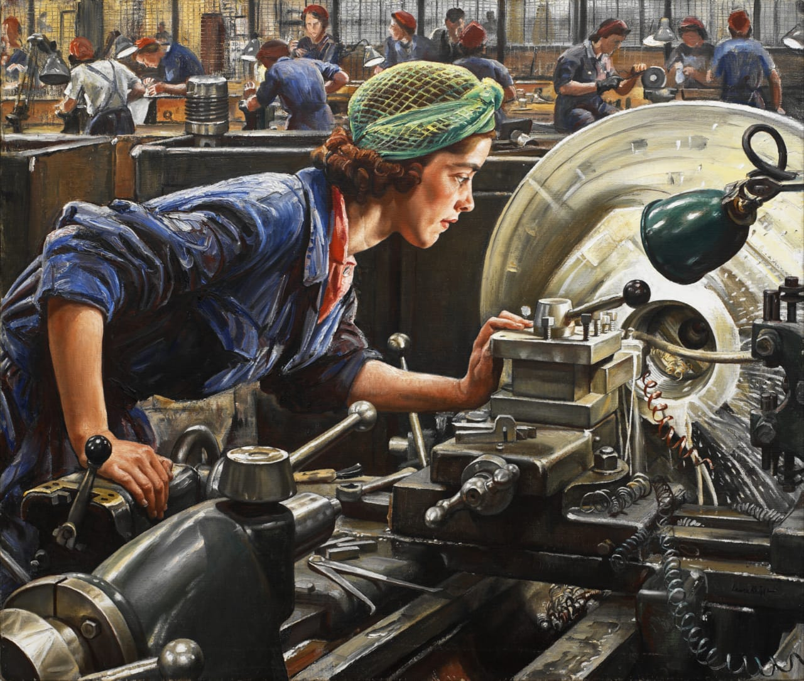
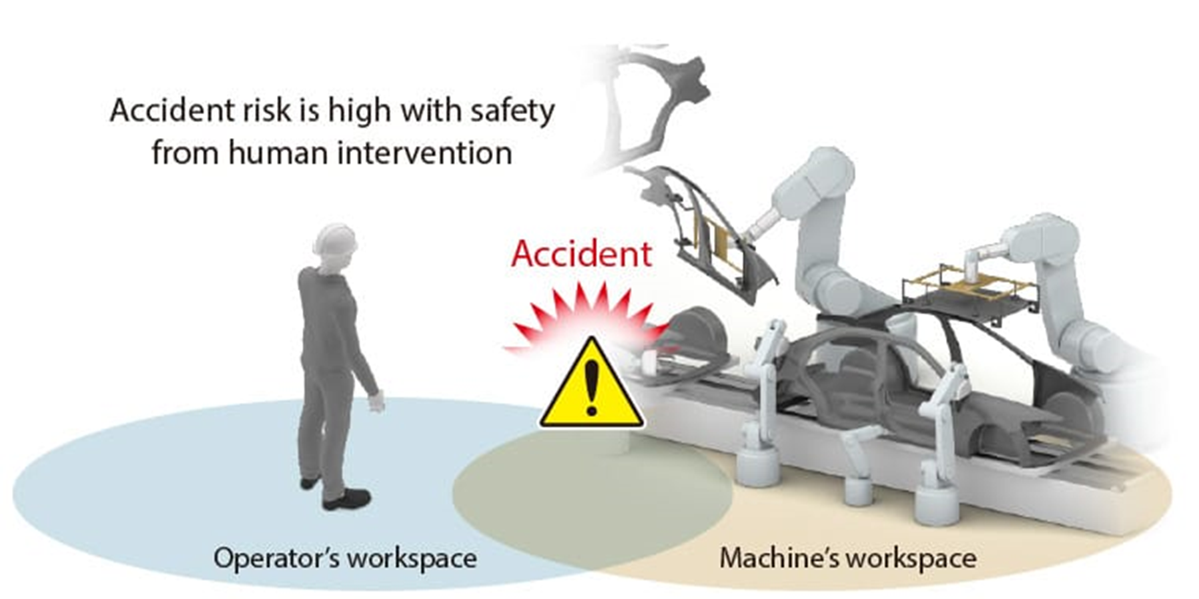
Objective
High cost for installing sensors and monitoring systems
Uneducated workers in factories
Irresponsible workers

Slide 6

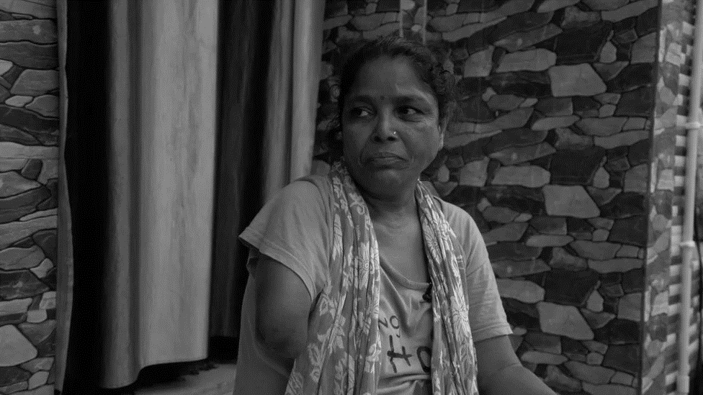
Motivation
Preventing accidents in industrial areas is an important concern
Work-related injuries were responsible for the deaths of 1.9 million people in 2019, according to the first joint estimates from the World Health Organization (WHO) and International Labour Organization (ILO).
According to the report on "Accidents and Deaths in Factories" published by the Ministry of Labour and Employment, Government of India, in 2019, there were a total of 54,865 industrial accidents reported in India.

Slide 7
Software & Hardware Specifications
Software Requirement:-
Sr No. | Software Component | Details(Technical details with Purpose)
1 | Operating System | Windows , MacOs ,Linux (Ubuntu 16.04) ,
2 | Technology | Python 3.8 +
3 | Tool | PyCharm/ VS Code
4 | Libraries | OpenCV , MediaPipe , TensorFlow , NumPy
Hardware Requirement:-
Sr.No. | Components | Specifications
1 | Laptop | Minimum 4GB RAM
2 | HDD | 100GB
3 | CCTV CAMERA | 3MP +

Slide 8
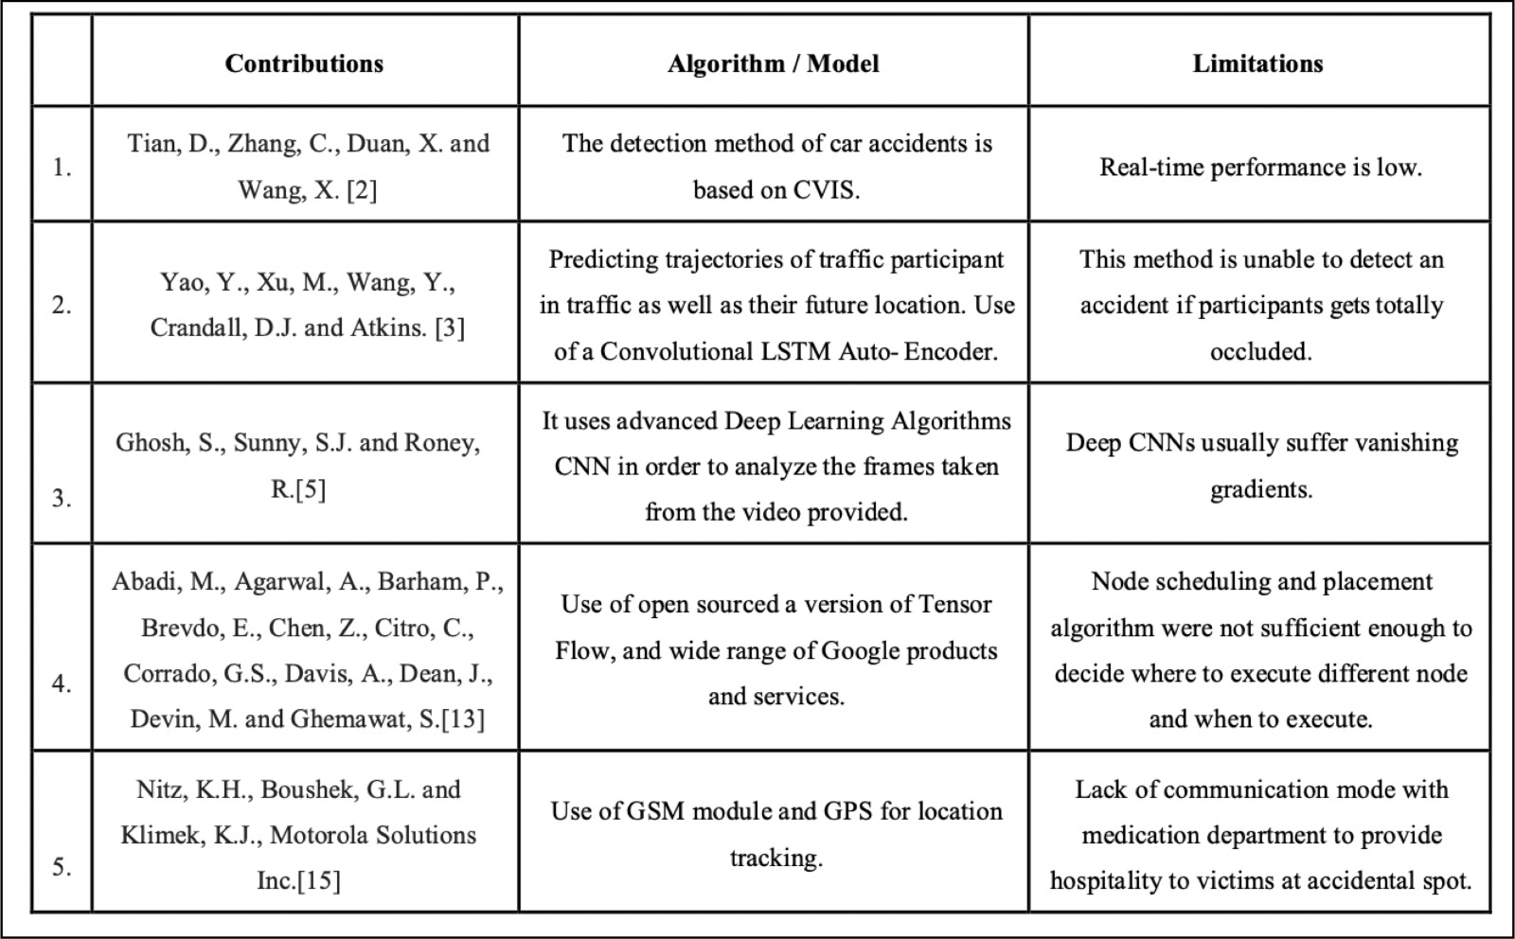
Literature Survey

Slide 9
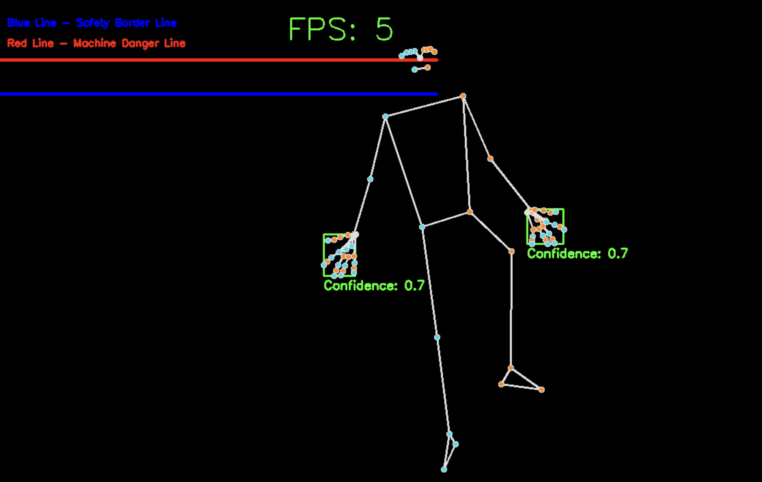
Need and Salient Features
The Threat Security Specialist project has the potential to significantly enhance security and safety in public places by providing an automated and non-intrusive posture detection system that can quickly identify potential threats.
The technology can also monitor workers’ physical health and safety in high-risk workplaces by detecting incorrect postures and movements.
This system has immense potential to reduce accidents and injuries, making it an essential project in today's world.
SafeZoneInnovators
8

Slide 10
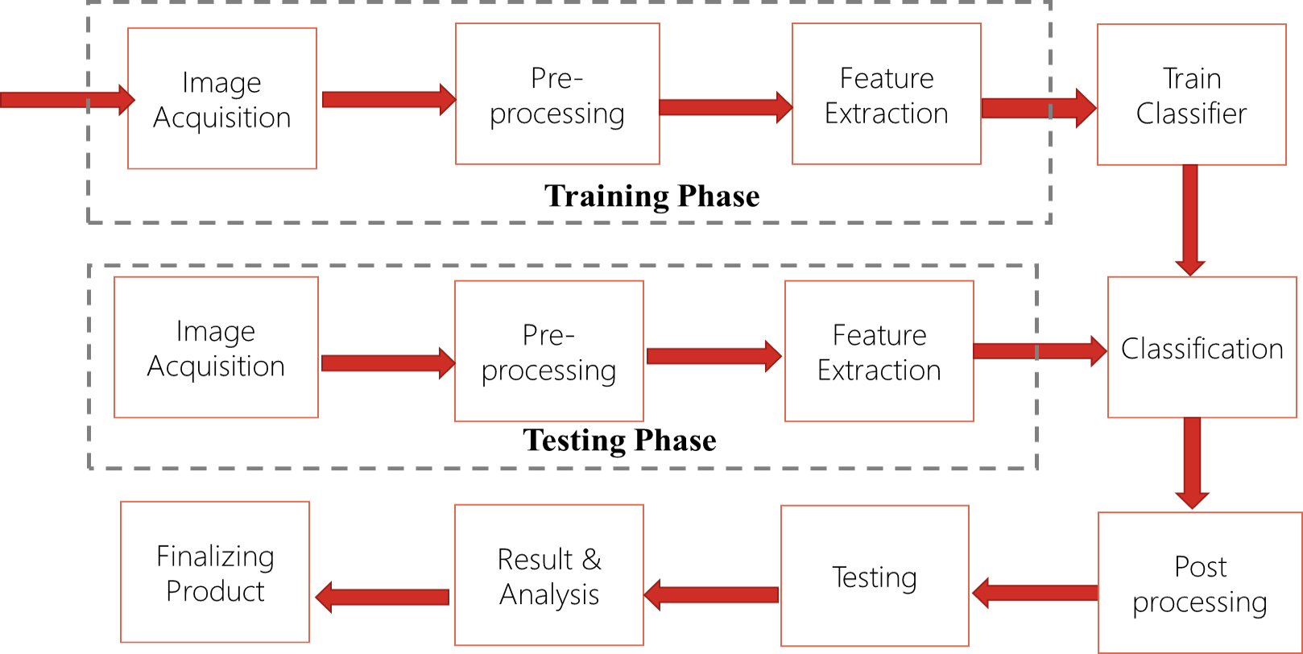
System Architecture
Block Diagram of Architecture

Slide 11
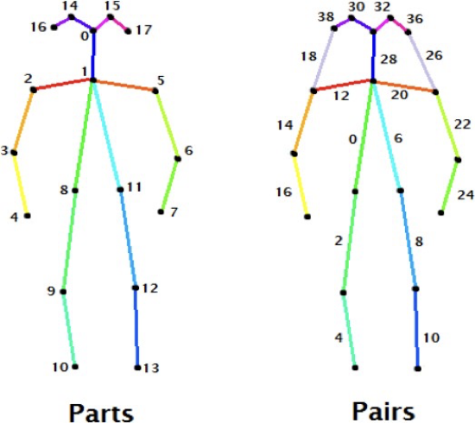
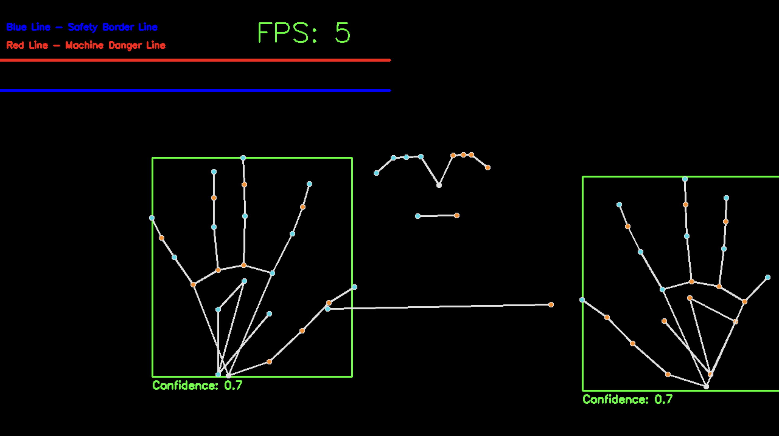
System Architecture
Nodes or Points that can
be detected using posture detection

Slide 12
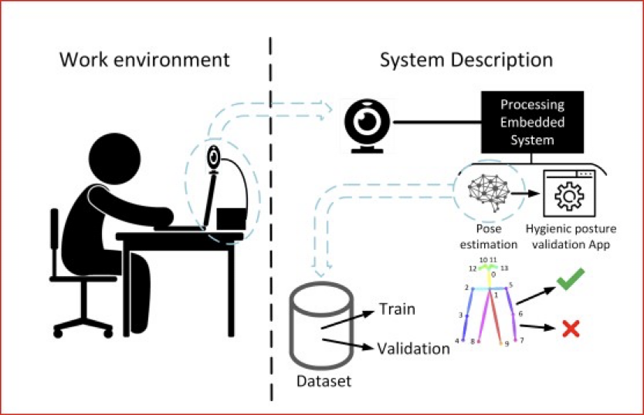
Working of the system
Utilise computer vision and machine learning techniques to analyse body movements and postures.
Rely on cameras to capture real-time data (frames per second) uses deep learning algorithms to analyse and interpret the data collected by the camera
Enables the system to detect anomalies in individuals' movements and postures and alert the personnel to take appropriate action
The media pipeline recognizes 21 different locations on the palm that accurately detect the presence of the hand in the environment.

Slide 13

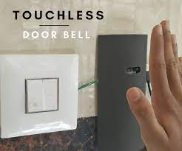
Realtime Application
There is a wide range of applications , here are few:
Prevents Theft: Safe guards expensive articles from robbery
like at museums, jewellery shops
2. Touch less doorbell :
Can ring the bell by detecting hand

Slide 14
Financial Business Model
Parameters | Photoelectric sensors | Ultrasonic sensors | Our system
Range | 3-4m | 4-5m approx. | Application specific
Robustness | Moderate | Low | BEST
Scope of False triggering | High | High | Low
Ease of upgradation | Low | Low | Better

Slide 15

Future Scope
Forming an Integrated System:
To integrate the system into chip which can be easily inserted into a smart CCTV camera.
By which the camera can detect the safety zone by itself ; which will ring the alarm .
II. Creating a Service Based Software:
Adding multi-dimensional view
Detecting multiple people at a time
Creating a user friendly software
III. Integrate IOT and EnTC devices:
With ESP32, Ardino, Rpie, Beaglebone to cut the power supply of the corresponding machines at factory

Slide 16
Conclusion
The posture detection system will utilize computer vision and machine learning techniques to analyze body movements and postures.
The system will use deep learning algorithms to analyze and interpret the data collected by the sensors. This will enable the system to detect anomalies in individuals' movements and postures and alert security personnel to take appropriate action.
The project will also involve developing an interface that enables users to interact with the system and customize the detection parameters to suit their specific needs.

Slide 17
Thanking you Team CodeMystics!

